Slide 1
Fine Milling
Josh Hornbeck

Slide 2
Reasons For Milling
Remove deteriorated pavement
Maintain existing elevation at curbs
Keying into existing pavement / bridge ends
Remove rutting in existing pavement
Texture existing pavement to provide good bond
Improve profile / IRI
Improve skid numbers

Slide 3
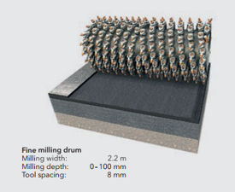
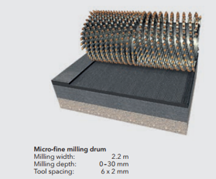

Slide 8
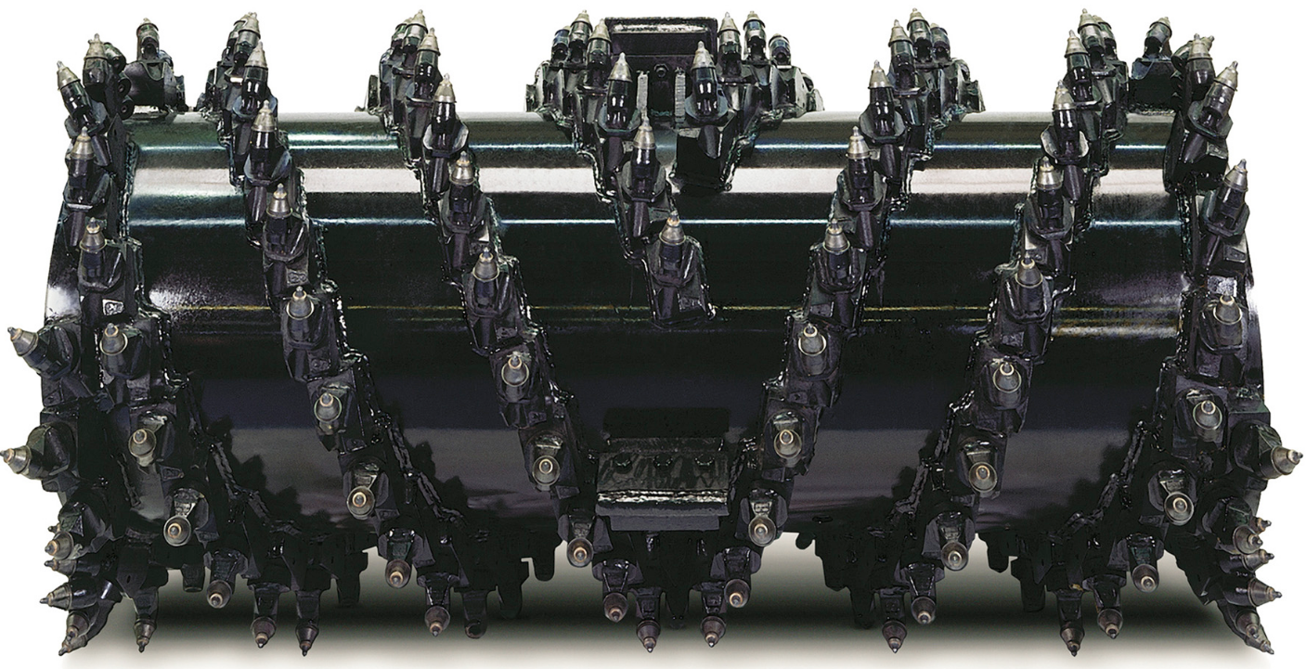
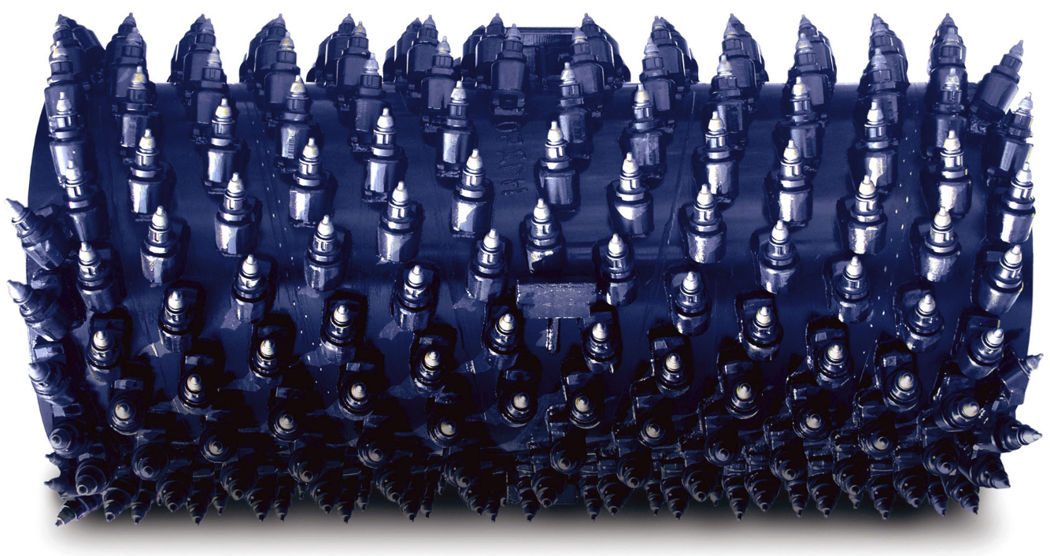
Machine Specification
Minimum tooth spacing

Slide 9
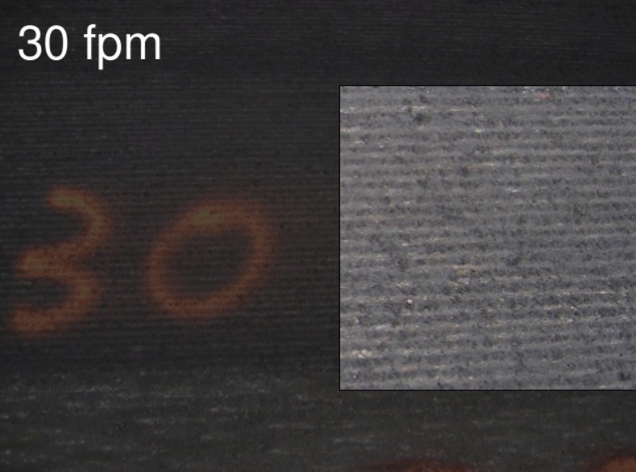
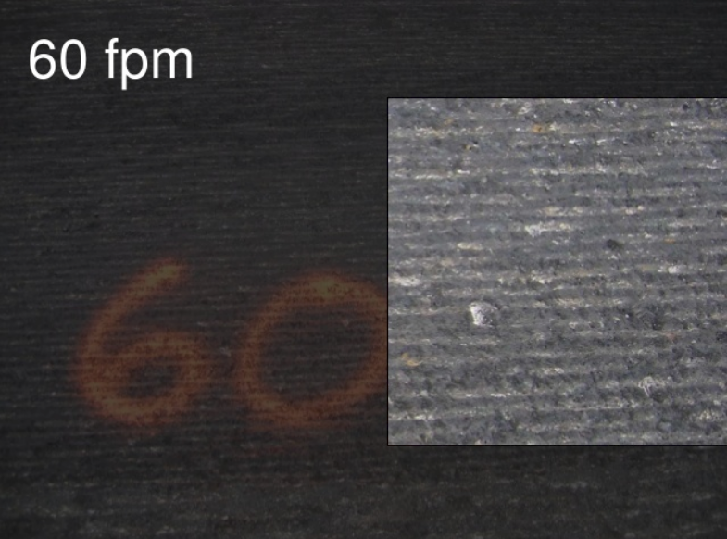
Machine Specification
Minimum drum RPM
Maximum machine speed
Limit machine speed based on drum RPM

Slide 10
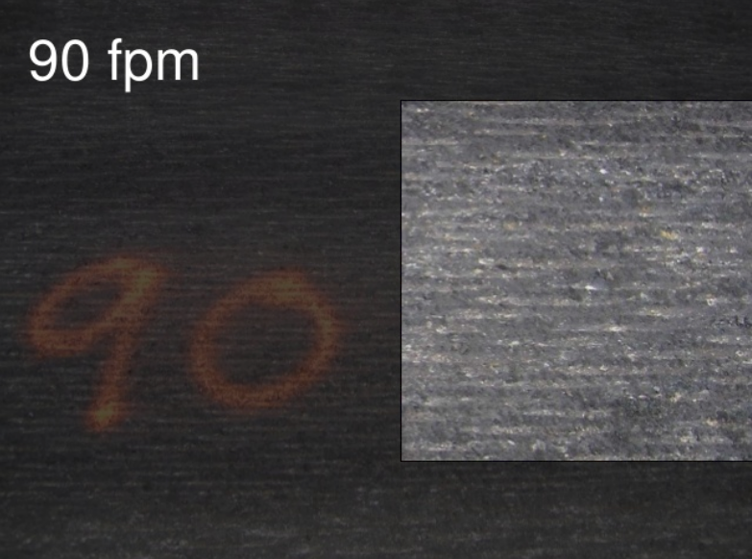
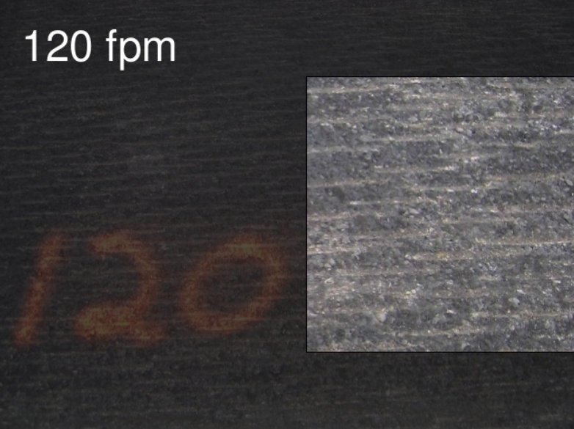
Machine Specification
Minimum drum RPM
Maximum machine speed
Limit machine speed based on drum RPM

Slide 11
Maintenance

Slide 12
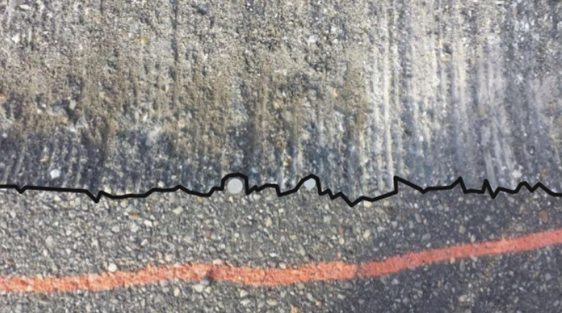
Maintenance

Slide 13
Performance Specification

Slide 14
Performance Specification Macrotexture Measurement

Slide 21
Special Note For Fine Milling

Slide 22
Special Note For Fine Milling
Macrotexture measurement 9.5” or greater
Grade averaging minimum 3 sensors minimum 20’ spacing
Payment by square yards

Slide 23
Cost Comparison

Slide 24
Production

Slide 25
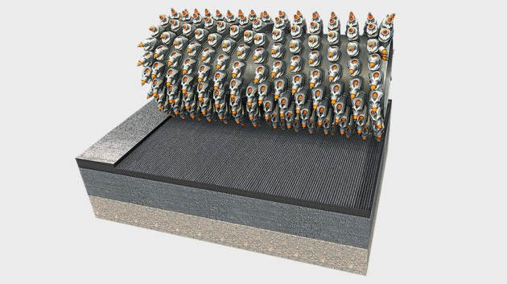
Questions?

